Slide 1
PHATCAT: Demo

Slide 2
Outline
Testing Environment and Scenario
Setting PHATCAT
Metering and Control with PHATCAT
PHATCAT’s Protection:
Instantaneous Overcurrent
Current Differential
Time-overcurrent Backup
Overexcitation
Harmonic Blocking

Slide 3
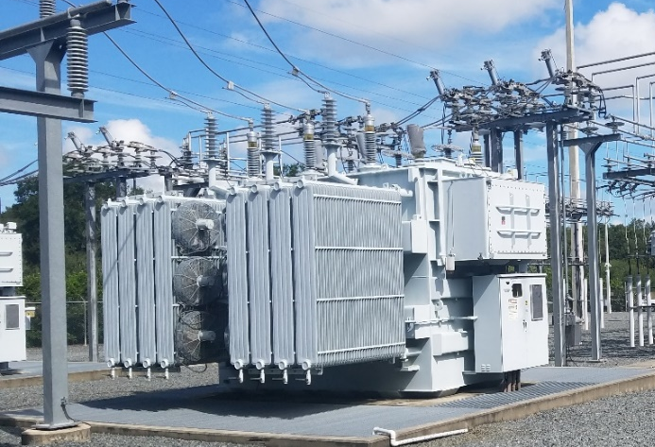
Our Transformer
Specification | Value
Apparent Power | 56 MVA
Voltage ratings | 69kV / 13kV
Connection | Y-Y
CT Ratios | 500:5 / 2500:5
PT Ratios | 600:1 / 120:1

Slide 4
Our Setup:
PHATCAT
The device under test
SEL-787
Industry-grade transformer protection
Used to capture oscillography
SEL-AMS
Simulates voltages, currents, and circuit breaker
Detects and times relay trips

Slide 5
Setting PHATCAT
A protection engineer can enter protection settings for PHATCAT using desktop app
They can also retrieve them from the relay
Let’s deploy proper settings to PHATCAT then read them back

Slide 6
Metering and Breaker Control
PHATCAT measures transformer’s voltages and currents, and derives phasors and other values
PHATCAT can control 125VDC relay circuits, such as those used for controlling circuit breakers
Let’s use PHATCAT to close a circuit breaker

Slide 7
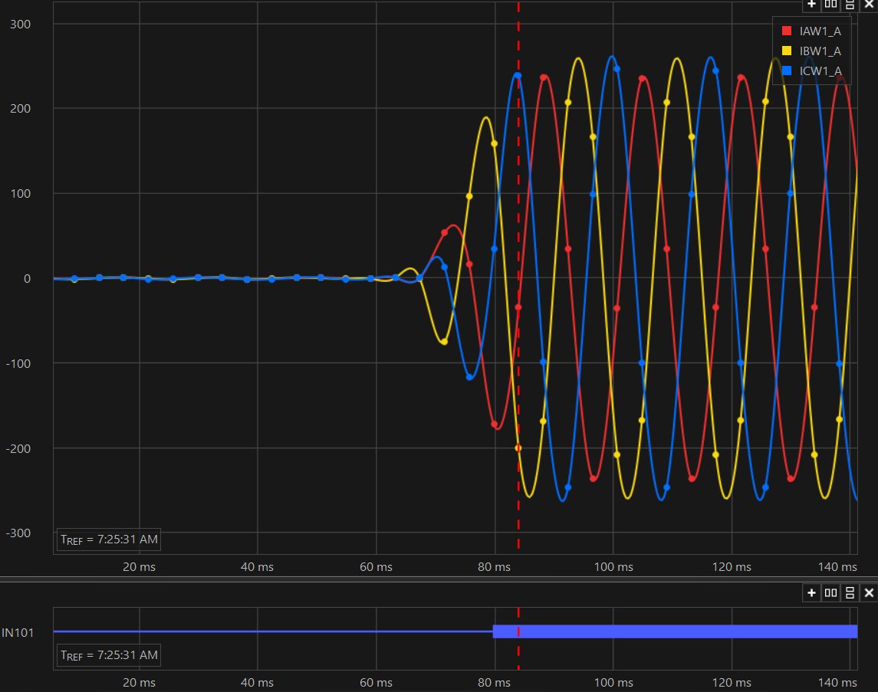
Breaker Closing

Slide 8
Instantaneous POC
Simple, but offers very high trip speed for close-in faults

Slide 9
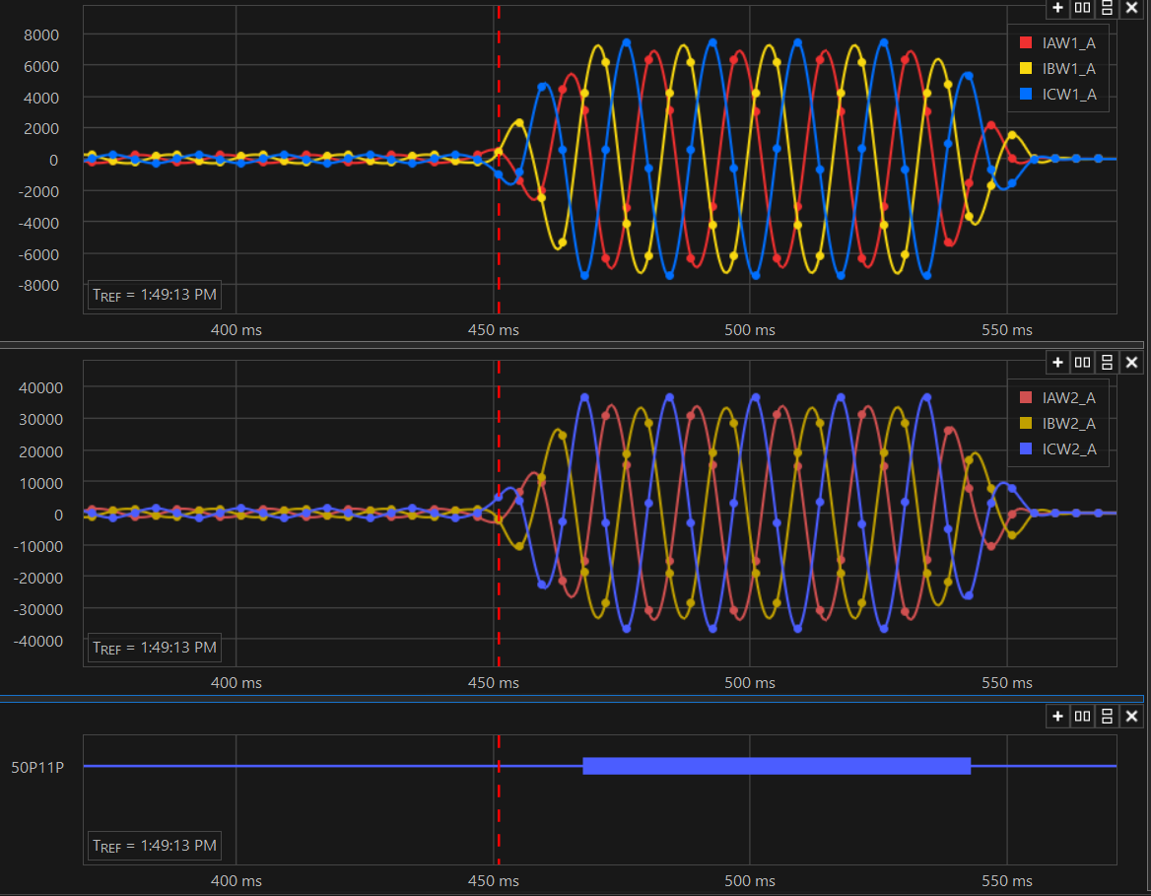
Bolted Bus Fault

Slide 10
Current Differential Protection
Based on Kirchhoff's Current Law
Should operate for faults inside transformer
Shouldn’t operate for faults outside transformer
Restrained Differential decreases sensitivity when errors may be large
Unrestrained Differential operates unconditionally for very big differential

Slide 11
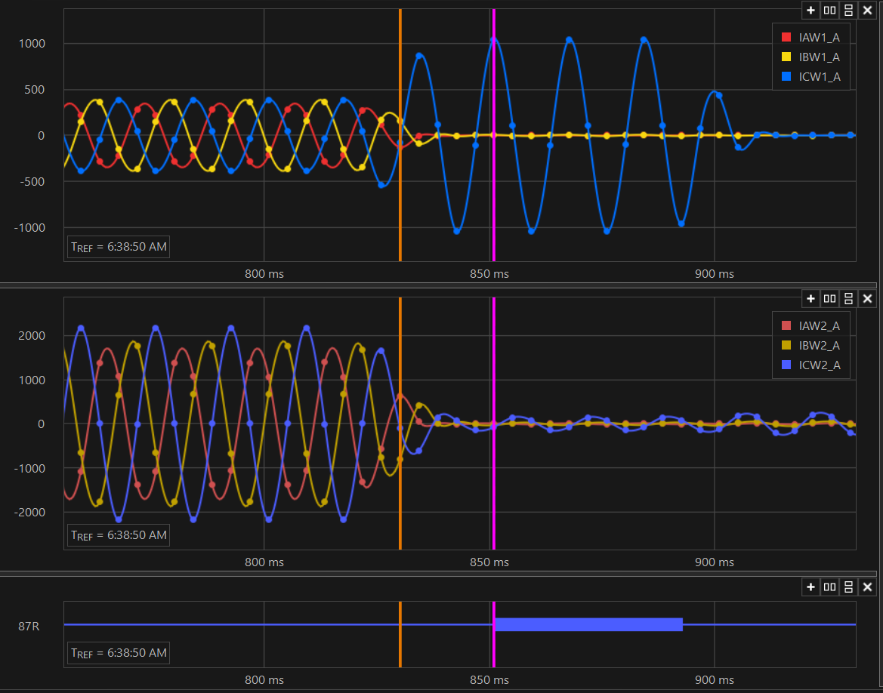
C-G Internal Fault:
(C-G internal fault)

Slide 12
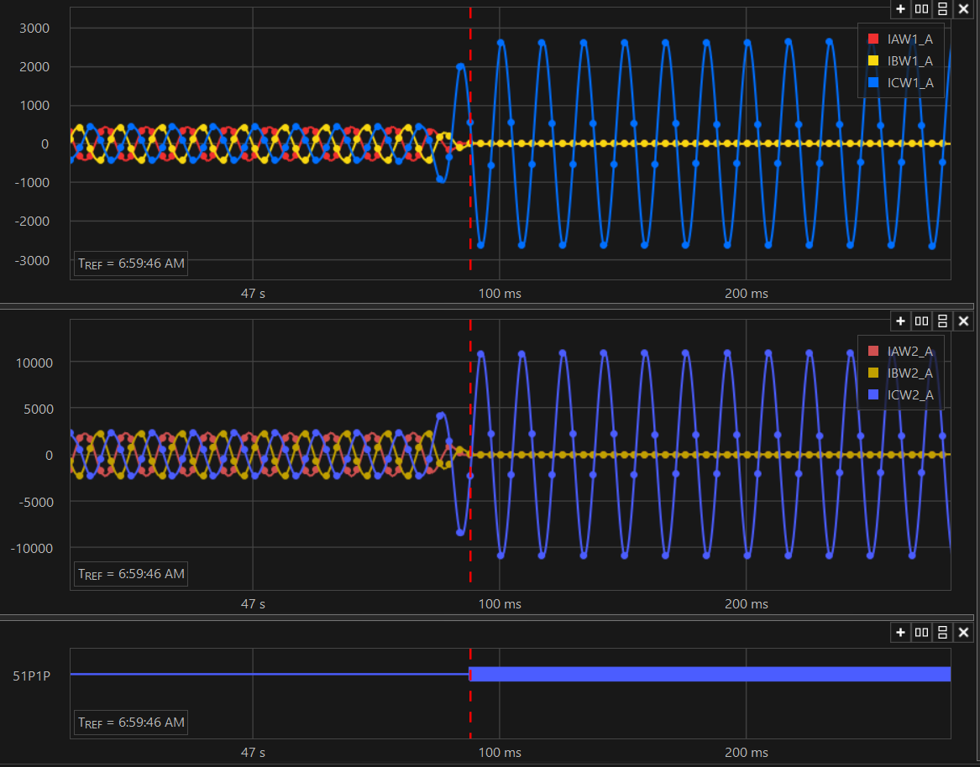
C-G External Fault, ~ 3 A_{sec} Error

Slide 13
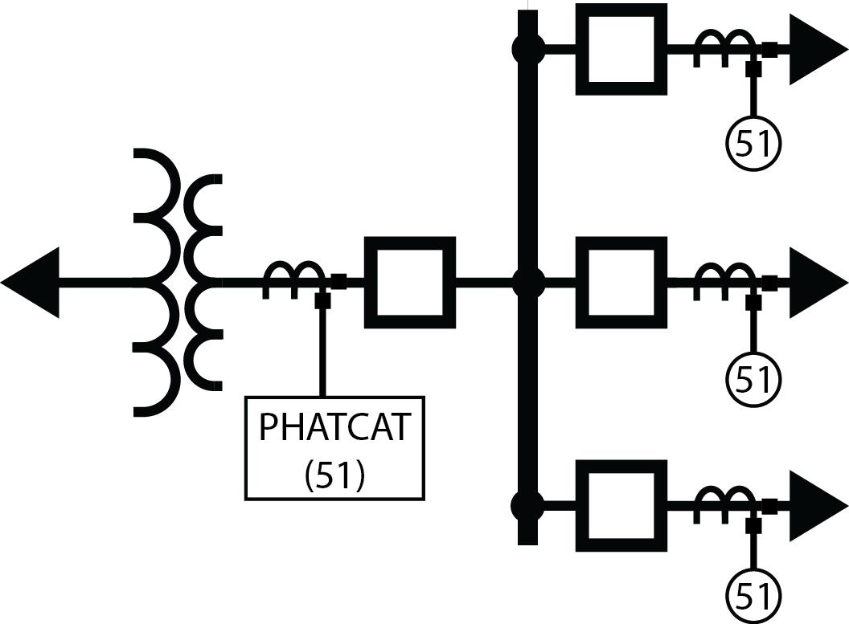
Time-Inverse Phase OC
Time-Inverse Overcurrent gives a operating time inversely related to fault current
Proper operating time key for coordination
In Transformers, it’s often used as a backup protection:

Slide 14
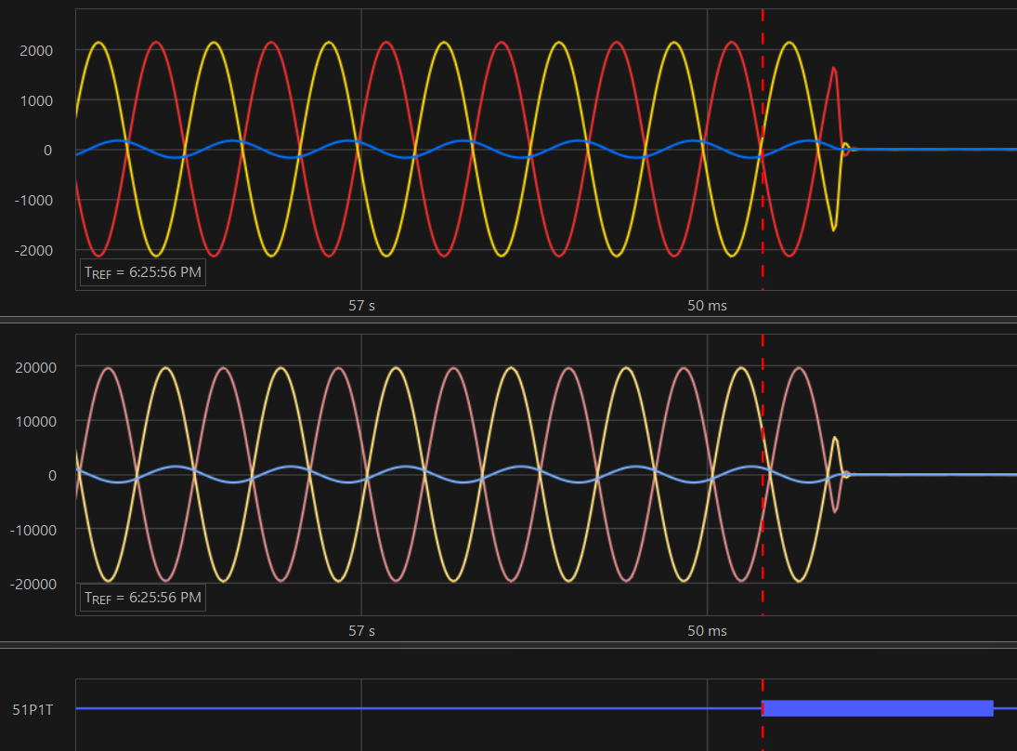
External A-B Fault:

Slide 15
Time-inverse GOC
Since normal system imbalance is low, offers greater sensitivity to ground faults
Consider a GOC set to protect downstream devices

Slide 16
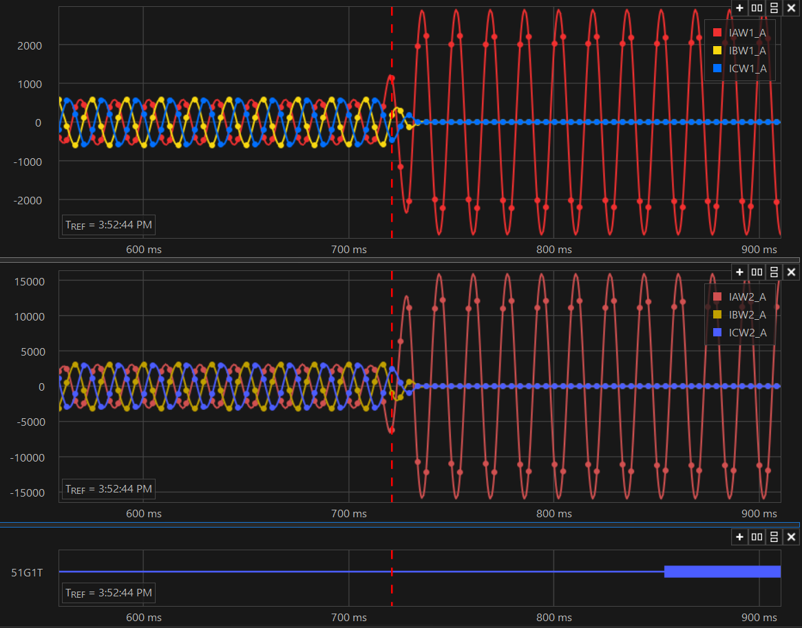
External Ground Fault

Slide 17
Overexcitation Protection
When voltage becomes too high and/or frequency too low, the magnetic fields inside the transformer can become too intense
Volts/Hz detects and trips for these conditions
Consider 20% overvoltage with 5Hz Frequency sag
Unrealistic condition, but demonstrates the principle

Slide 18
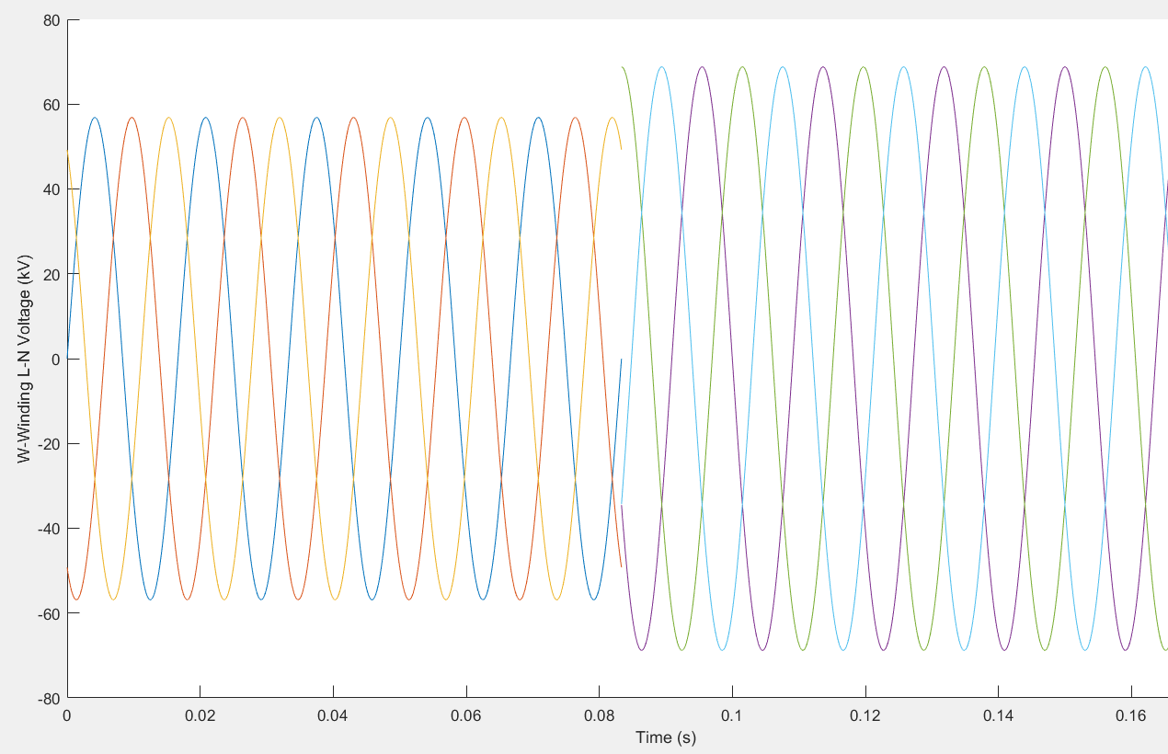
OV/UF Event:

Slide 19
Questions?

Slide 20
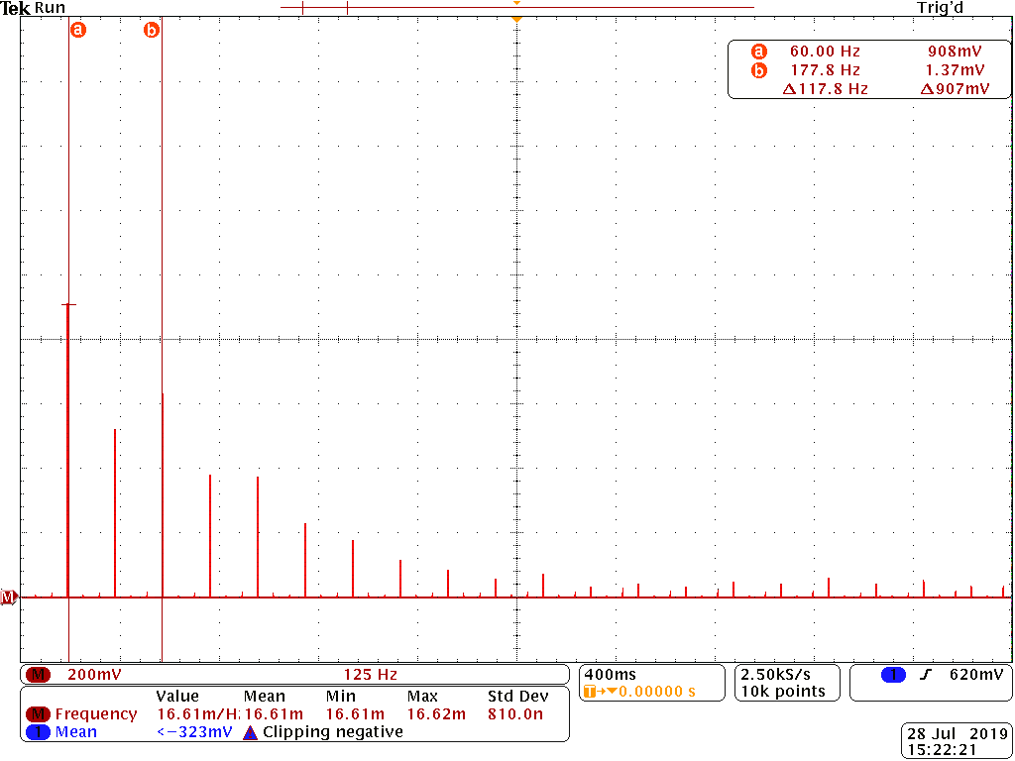

Slide 21
Harmonic Blocking
Transformers draw a lot of current when energized
Will cause differential to incorrectly trip unless…
Harmonic blocking is used to detect energization and block the differential

Slide 22
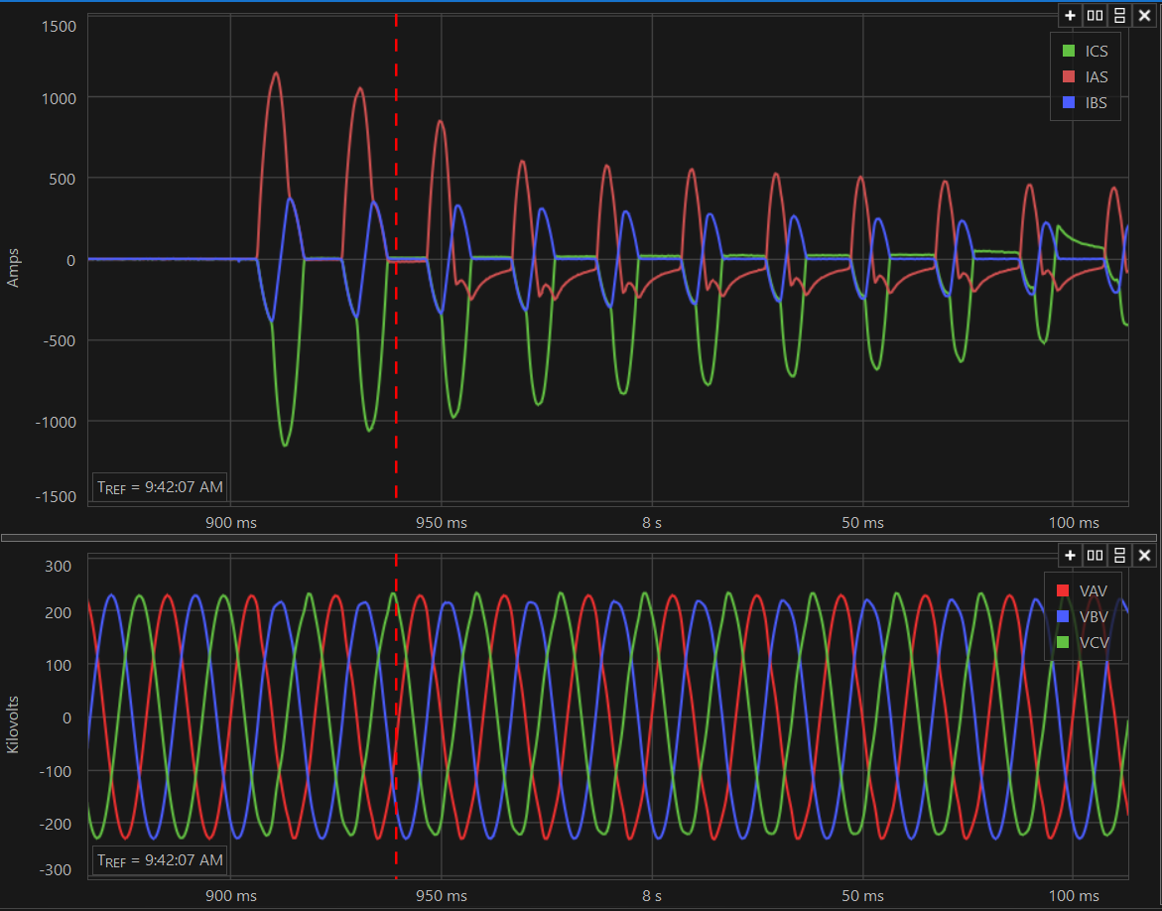
Transformer Inrush

Slide 23
Harmonic Blocking
Due to compatibility issues with available COMTRADE files, we could only performed proof of concept testing in lab
Video demonstrates harmonic blocking element picking up for harmonic content in pulses from function generator

